Slide 1
Text Similarity API
Mingming Qiu
mq33982p@pace.edu

Slide 2
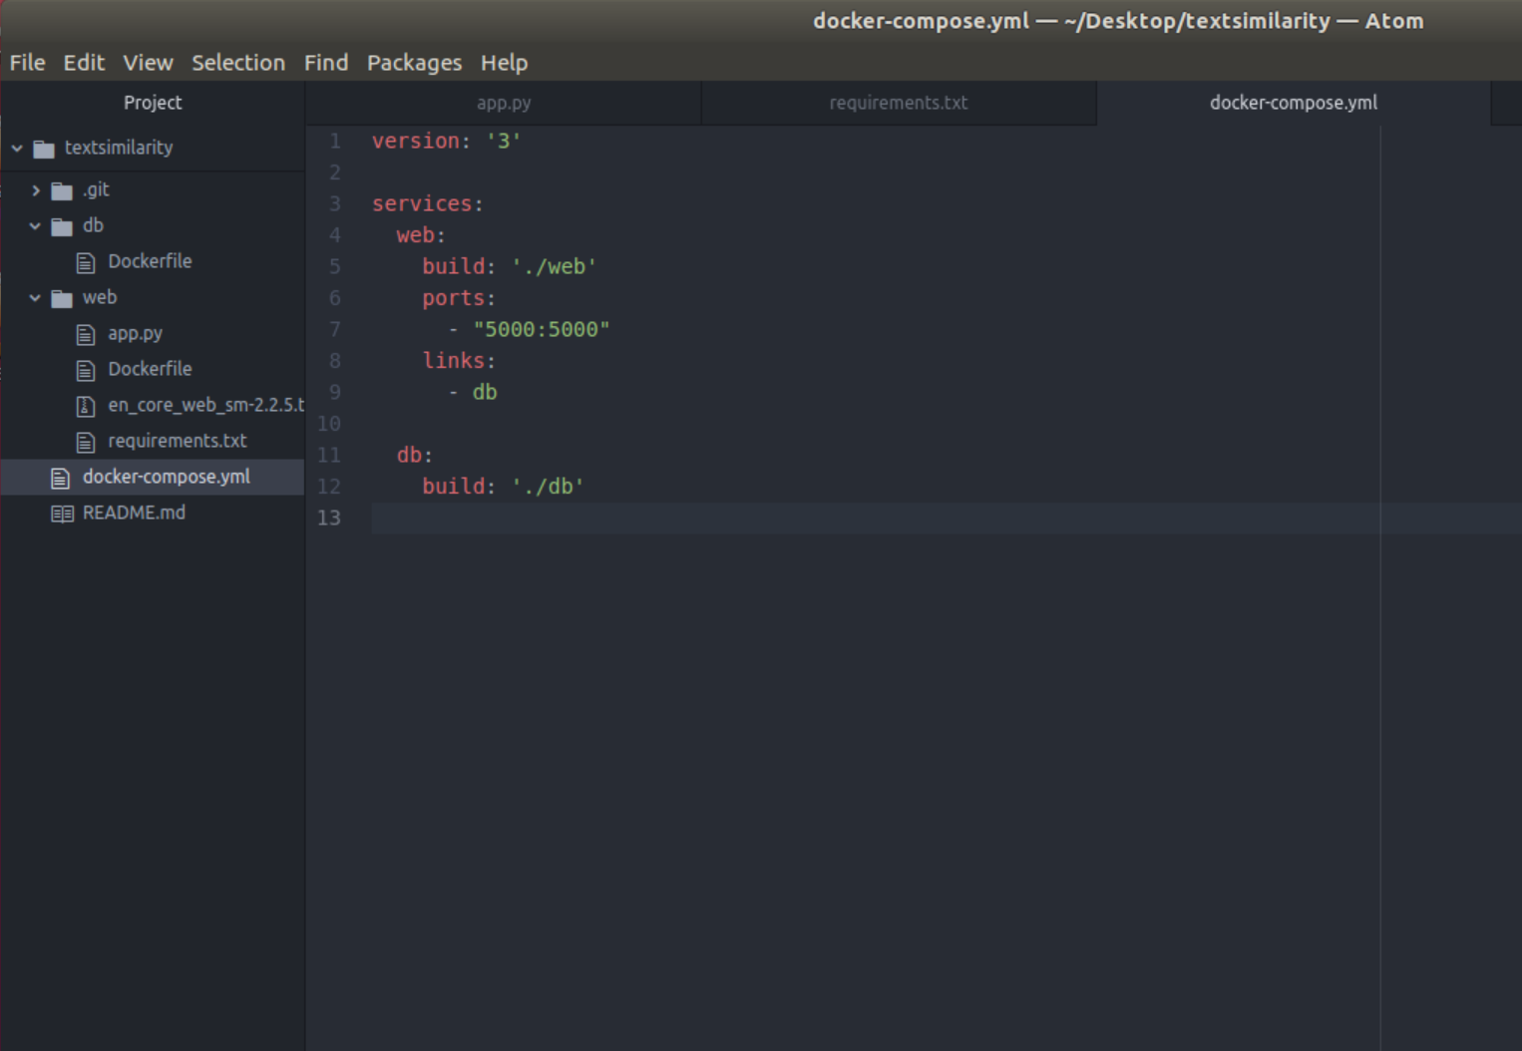
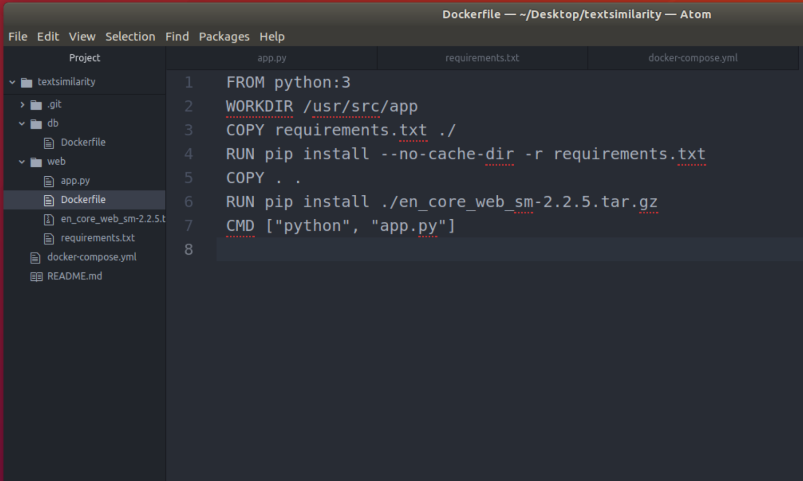
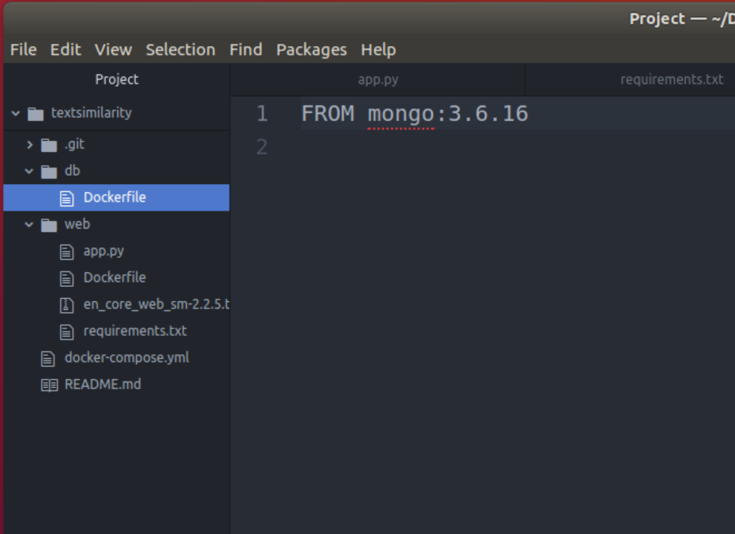

Slide 3
